Slide 1


Computer Networks
Panel G: Dr. Shamla Mantri
Teaching Scheme Credits: 3 + 1 = 4
Theory: 3 Hrs / Week
Practical: 2 Hrs / Week
15/03/2022

Slide 2
Learning Resources: Text & Reference Books
Text Books: Behrouz A. Forouzan, ‘Data Communications and Networking’, 5th Edition, McGraw-Hill Publishing Company, ISBN 978-0-07-337622-6 Tanenbaum A. S., ‘Computer Networks’, Pearson Education , 5th Edition, ISBN-978-0-13-212695-3 Reference Books: James F. Kurose and Keith W Ross ‘Computer Networking, A Top-Down Approach’, 5th Edition, Pearson Education, ISBN- 978-81-317-9054-0 W. Richard Stevens, Unix Network Programming, The Sockets Networking API, Vol 1, 3rd Edition, PHI Learning Pvt. Ltd. Supplementary Reading: William Stallings, ‘Data and Computer Communications’, 6th Edition, Prentice Hall of India Pvt. Web Resources: https://nptel.ac.in/courses/106/105/106105080/ https://nptel.ac.in/courses/106/106/106106091/ Web links: https://nptel.ac.in/courses/106/105/106105081/ https://nptel.ac.in/courses/106/105/106105183/ https://ocw.mit.edu/courses/electrical-engineering-and-computer-science/6-829-computer-networks-fall-2002/index.htm MOOCs: https://www.coursera.org/learn/computer-networking https://www.edx.org/course/introduction-to-networking?index=product&queryID=0befdc538866babf2facfdc2dce06204&position=1

Slide 3
Syllabus Module 2: Data Link Layer:
Data Link Layer Services.
Types of errors.
Block coding.
Error Control: Cyclic Redundancy Check (CRC) Code, Hamming Code, Checksum.
Sliding window Protocols: Selective Repeat (SR) & Go Back N (GBN)
Channel allocation, Multiple Access Protocols: ALOHA, CSMA/CD, CSMA/CA
Ethernet Frame format.

Slide 4
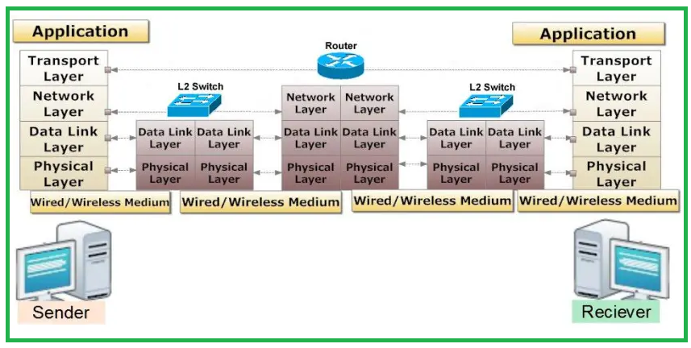
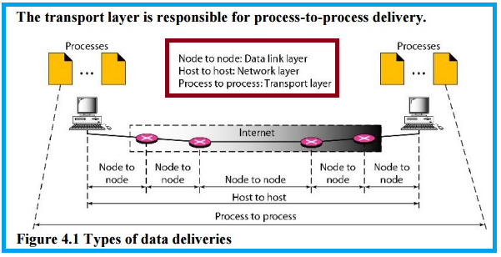

Slide 5
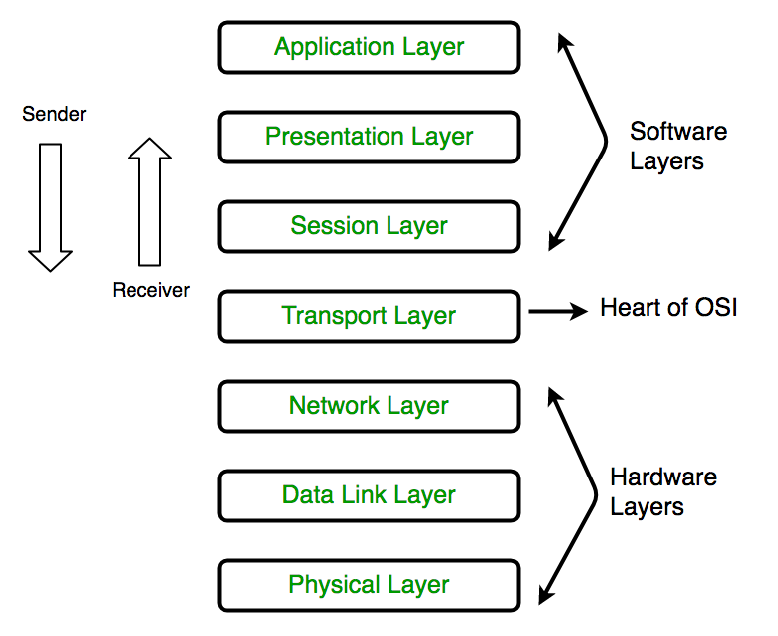
Physical Layer
The lowest layer of the OSI reference model is the physical layer.
It is responsible for the actual physical connection between the devices.
The physical layer contains information in the form of bits.
It is responsible for transmitting individual bits from one node to the next.
When receiving data, this layer will get the signal received and convert it into 0s and 1s and send them to the Data Link layer
Data link layer put the frame back together.

Slide 6
Functions of the Physical Layer
Bit synchronization:
The physical layer provides the synchronization of the bits by providing a clock. This clock controls both sender and receiver thus providing synchronization at bit level.
Bit rate control:
The Physical layer also defines the transmission rate i.e. the number of bits sent per second.
Physical topologies:
Physical layer specifies the way in which the different, devices/nodes are arranged in a network i.e. bus, star, or mesh topology.
Transmission mode:
Physical layer also defines the way in which the data flows between the two connected devices. The various transmission modes possible are Simplex, half-duplex and full-duplex.

Slide 7
Physical Layer devices:
Hub, Repeater, Modem, Cables etc.
Network Layer, Data Link Layer, and Physical Layer are also known as Lower Layers or Hardware Layers.
E2=1110 001 0

Slide 8
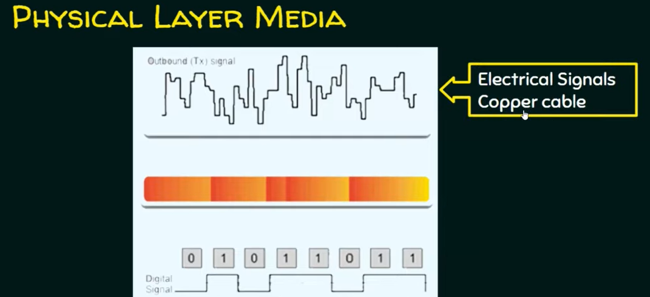
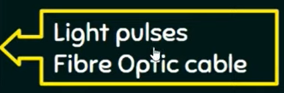
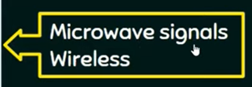

Slide 9
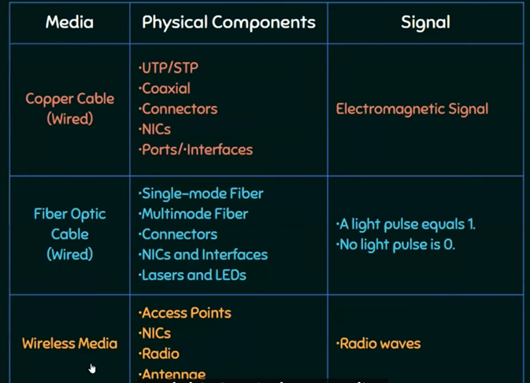

Slide 10


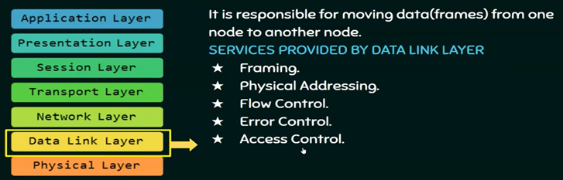
https://www.youtube.com/watch?v=VBAuzvVzOQU&list=PLBlnK6fEyqRhstjOChz8zuHiFoKGPMr9v

Slide 11
Data Link Layer
The data link layer is responsible for the node-to-node delivery of the message.
The main function of this layer is to make sure data transfer is error-free from one node to another, over the physical layer.
When a packet arrives in a network, it is the responsibility of DLL to transmit the packet to the Host using its MAC address -48 bits. (media access control address).

Slide 12
Data Link Layer
Data Link Layer is divided into two sublayers:
Logical Link Control (LLC)
Media Access Control (MAC)
The packet received from the Network layer is further divided into frames depending on the frame size of NIC (Network Interface Card).
DLL also encapsulates Sender and Receiver’s MAC address in the header.

Slide 13
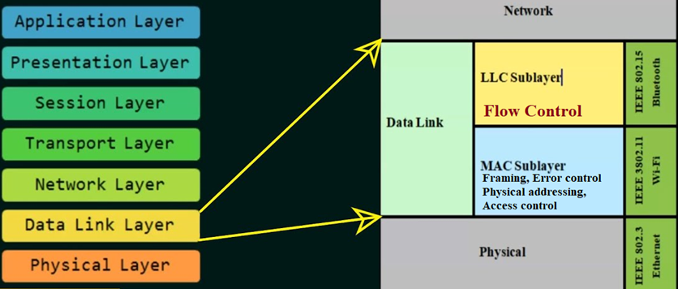
Data Link Layer is divided into two sublayers:

Slide 14
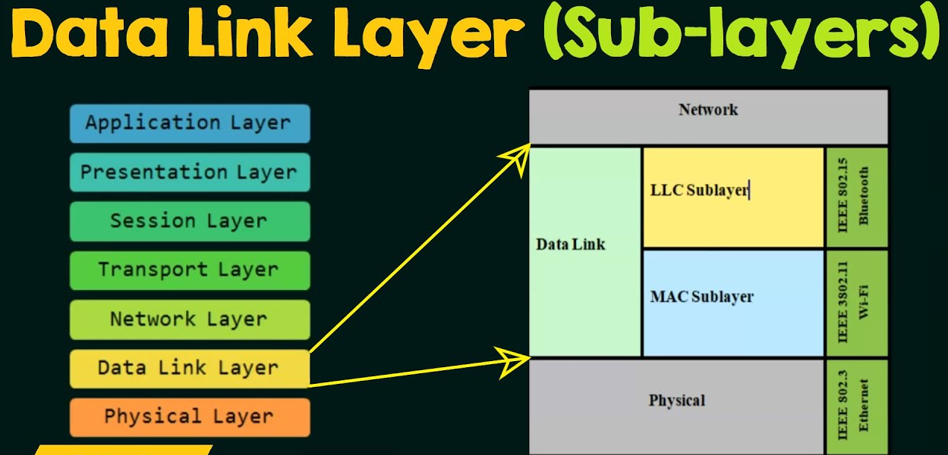
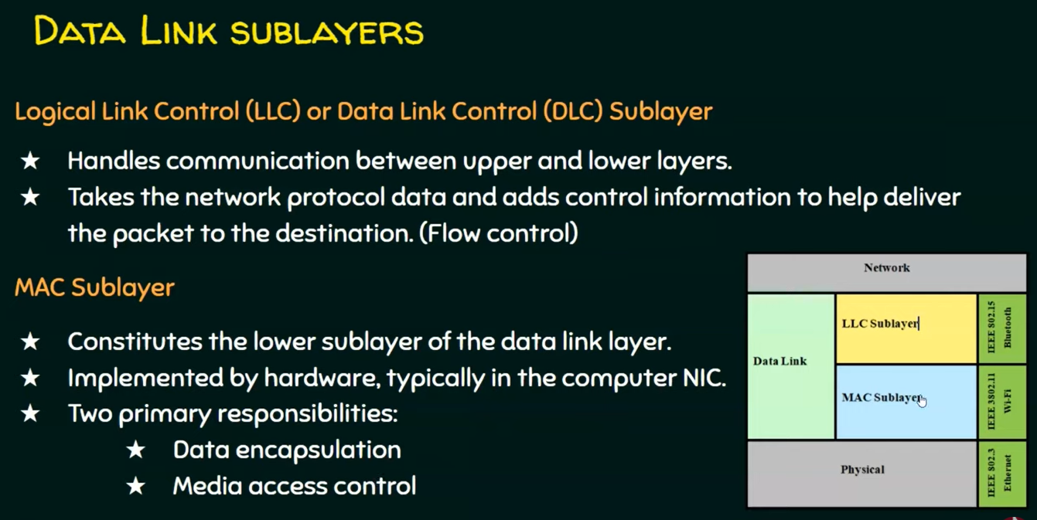

Slide 15

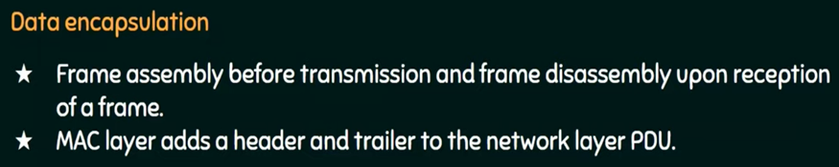
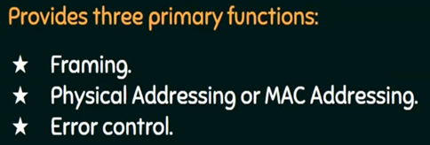

Slide 16
Functions of Data Link Layer
Framing:
Framing is a function of the data link layer.
It provides a way for a sender to transmit a set of bits that are meaningful to the receiver.
This can be accomplished by attaching special bit patterns to the beginning and end of the frame.
Physical addressing:
After creating frames, the Data link layer adds physical addresses (MAC address) of the sender and/or receiver in the header of each frame.
Error control:
Data link layer provides the mechanism of error control in which it detects and retransmits damaged or lost frames.

Slide 17
Functions of Data Link Layer
Flow Control: The data rate must be constant on both sides else the data may get corrupted thus, flow control coordinates the amount of data that can be sent before receiving acknowledgement.
Access control: When a single communication channel is shared by multiple devices, the MAC sub-layer of the data link layer helps to determine which device has control over the channel at a given time.
Packet in Data Link layer is referred to as Frame.
Data Link layer is handled by the NIC (Network Interface Card) and device drivers of host machines.
Switch & Bridge are Data Link Layer devices.

Slide 18
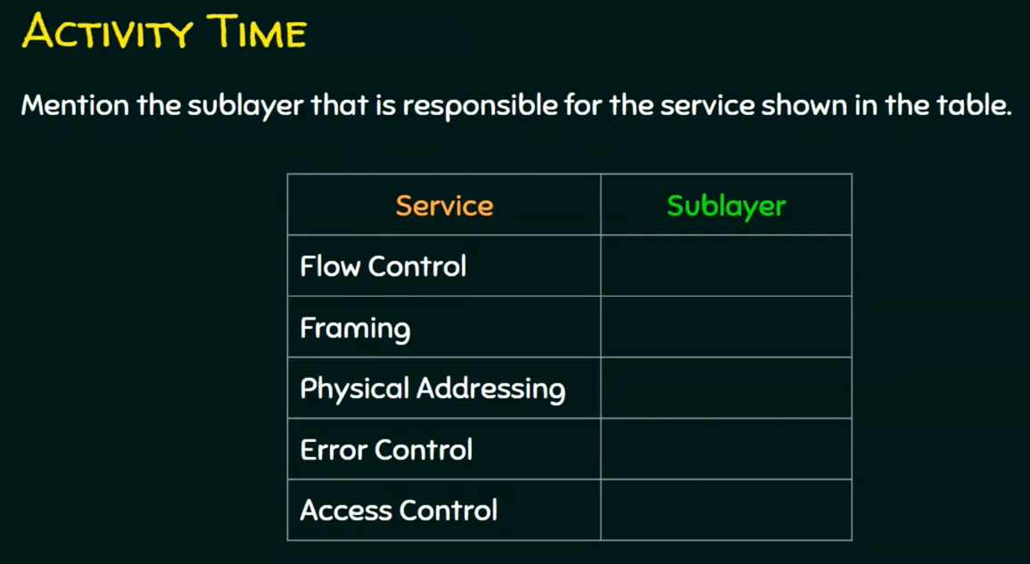

Slide 19
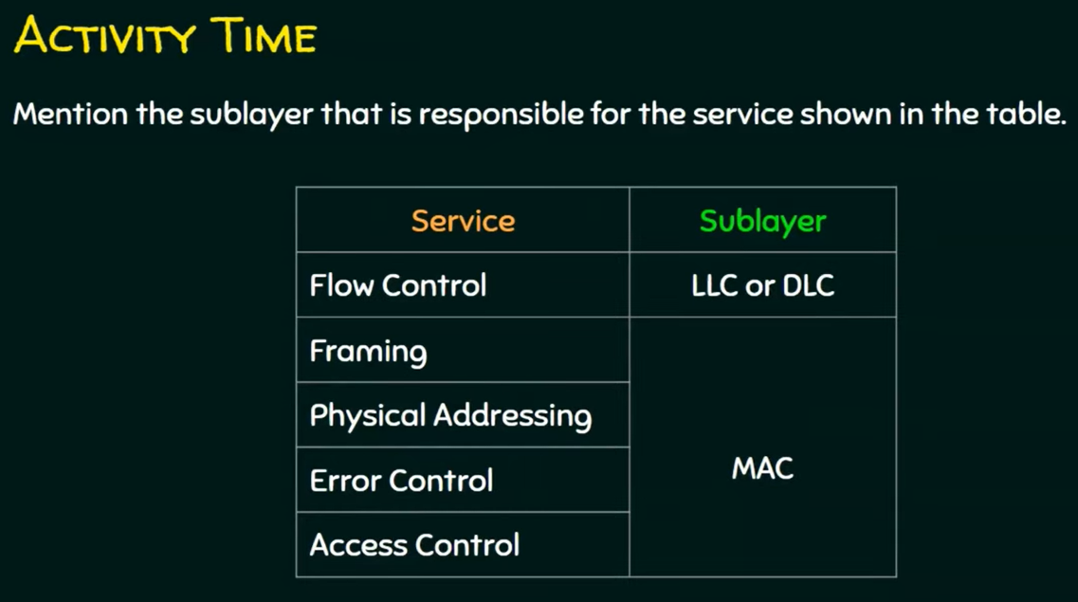

Slide 20
Just a Minute - Quiz
1. No. of layers in OSI Model
(a) 5 (b) 7 (c ) 3 (d) 4
2. Term Frame is referred at
(a) Data Link Layer (b) Physical Layer (c ) Network Layer (d) None
3. Term packer is referred at
(a) Data Link Layer (b) Physical Layer (c ) Network Layer (d) None
4. Routers are used at
(a) Data Link Layer (b) Physical Layer (c ) Network Layer (d) None
5. Switches are used at
(a) Data Link Layer (b) Physical Layer (c ) Network Layer (d) None

Slide 21
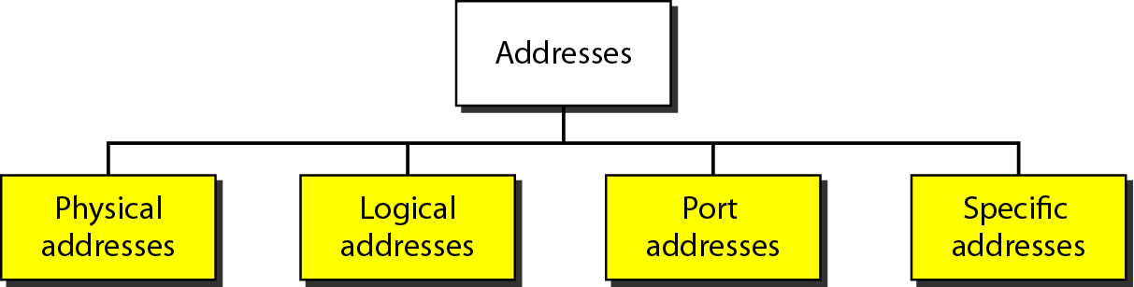
Addresses in TCP/IP Network

Slide 22
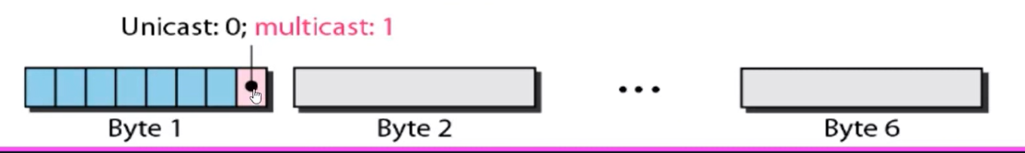
Link Layer Address
Six bytes = 48 bits
Flat address not hierarchical
Burned into the NIC ROM
First three bytes from left specify the vendor. Cisco 00-00-0C, and 02-60-8C and the last 24 bit should be created uniquely by the company.
Destination Address can be:
Unicast: second digit from left is even (one recipient)
Multicast: Second digit from left is odd (group of stations to receive the frame – conferencing applications)
Broadcast (ALL ones) (all stations receive the frame)
Source address is always Unicast
00-00-0C-02-60-8C

Slide 23
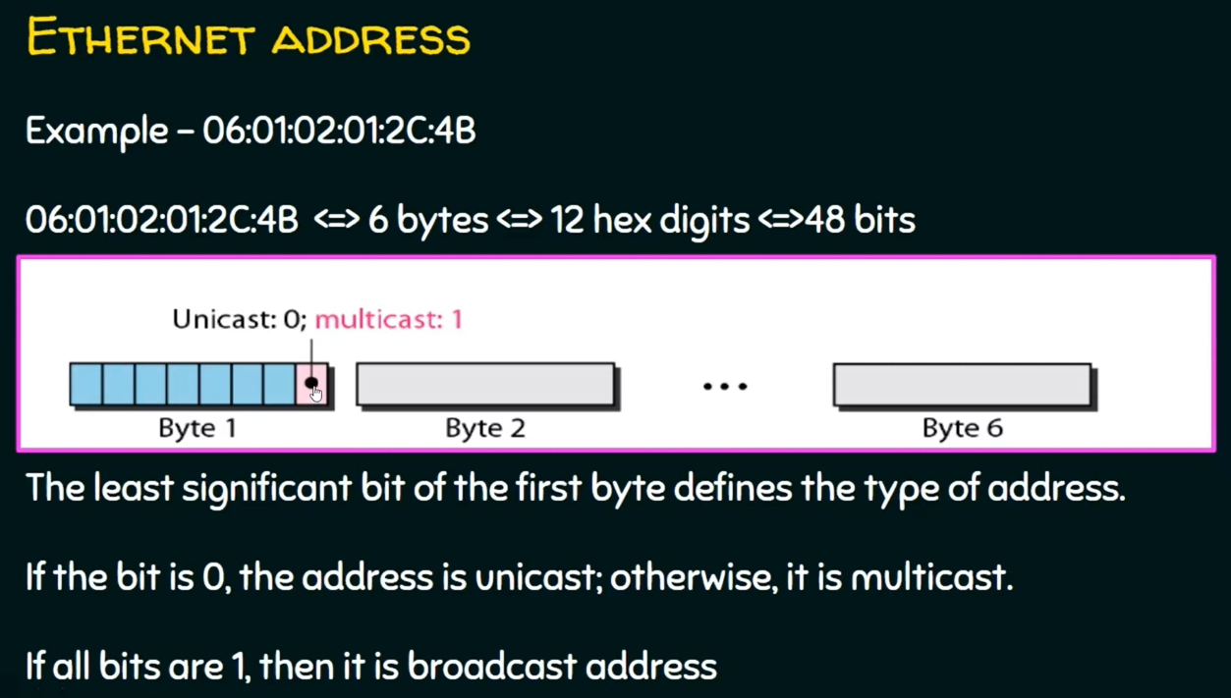

Slide 24
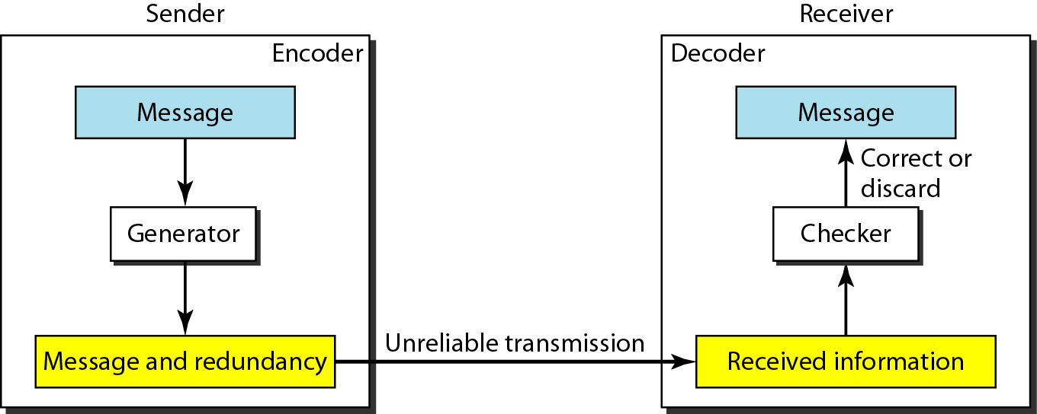
Error Control
To detect or correct errors, we need to send extra (redundant) bits with data.
Enough redundancy is added to detect an error.
In error detection, the receiver knows an error occurred but does not know which bit(s) is (are) in error.
Error detection has less overhead than error correction.

Slide 25
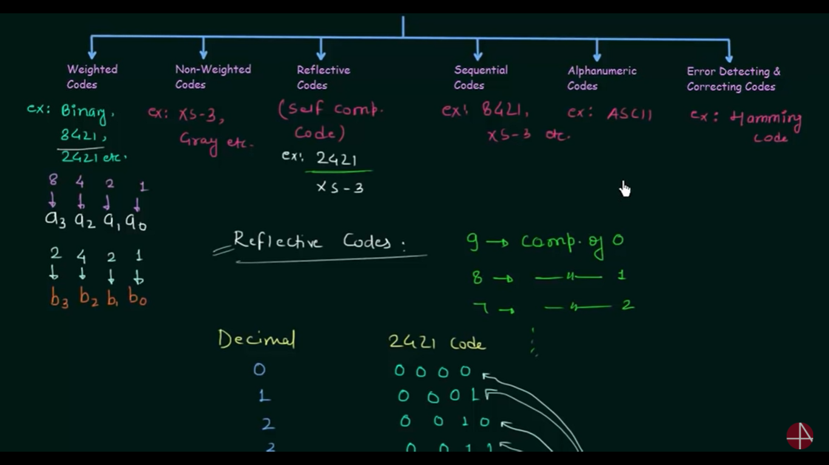
Classification of Codes

Slide 26
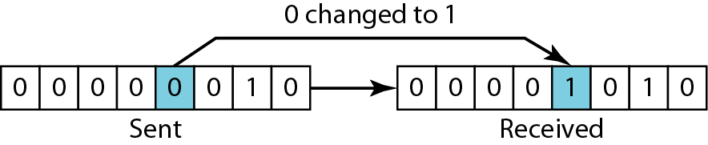
Errors
Data can be corrupted during transmission. Some applications require that errors be detected and corrected.
Types of Errors: Single bit and burst error
1. In a single-bit error, only 1 bit in the data unit has changed.

Slide 27
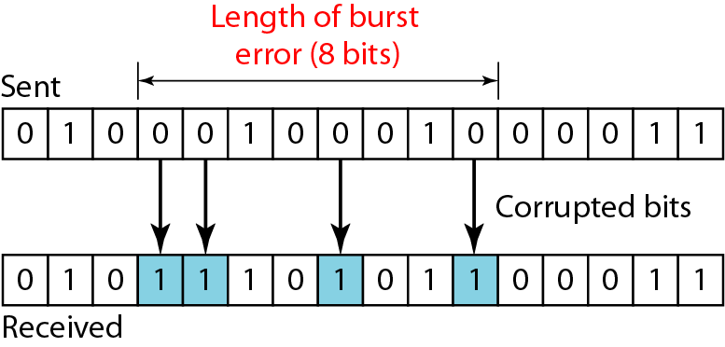
Types of Errors cont-
2. A burst error means that 2 or more bits in the data unit have changed.
To detect or correct errors, we need to send extra (redundant) bits with data.

Slide 28
The structure of encoder and decoder

Slide 29
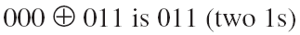
Hamming Distance
The Hamming distance between two words is the number of differences between corresponding bits.
Let us find the Hamming distance between two pairs of words.
1. The Hamming distance d(000, 011) is 2 because
2. The Hamming distance d(10101, 11110) is 3 because

Slide 30
Hamming Code (error detecting and correcting )
Hamming Codes are the family of linear error correcting codes invented by Richard hamming in 1950.
Hamming code can detect up to two-bit errors or correct one-bit errors without detection of uncorrected errors.
Easy to implement.
Commonly 7/8 bit hamming code is used. (But we can use hamming code greater than this).
Must Watch: https://www.youtube.com/watch?v=X8jsijhllIA

Slide 31
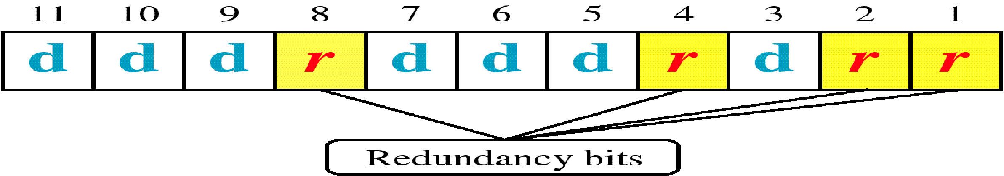
Hamming Code
In hamming code the bits of the code word are numbered consecutively starting with bit 1, and bit 2, & so on
The bits that are power of ‘2’ are ‘r’ – Check bits (parity bits) (e.g. 1, 2, 4, 8, ..)
The rest (e.g. 3, 5, 6, 7, 9, 10, 11, …..) are filled with ‘m’ – Data bits.
The pattern is shown for an (n, m) here (11,7) where
‘m’ = data bits = 7, ‘r’ = check bits = 4, ‘n’ = code word = 11
The value of r must satisfy the following relation: 2^{r} ≥ m+r+1= (2^4>=7+4+1)=16>=12

Slide 32
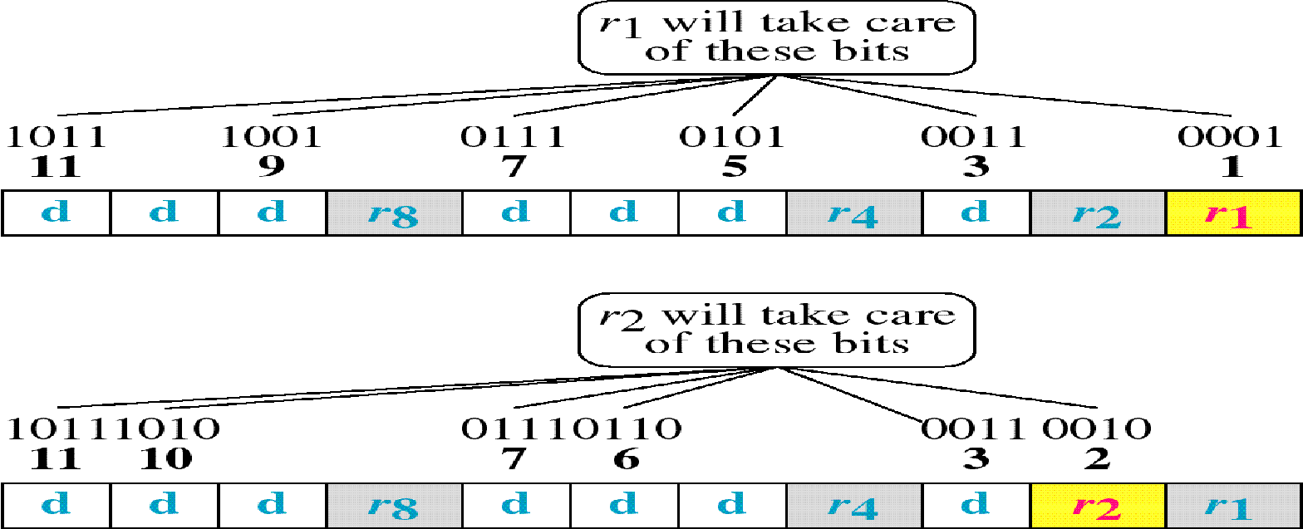
Hamming Code
R1 = D3, D5, D7, D9, D11 => (Consecutive or Alternate 1 Bit including r1 itself).
R2 = D3, D6, D7, D10, D11 => (Consecutive or Alternate 2 Bit including r2 itself).

Slide 33
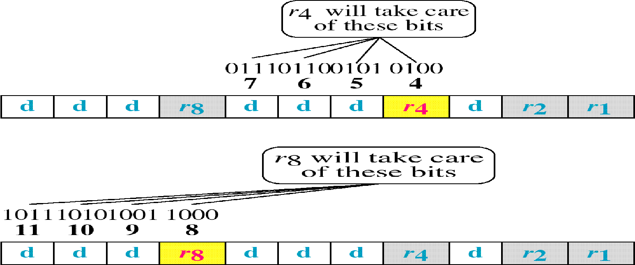
Hamming Code
R4 = D5, D6, D7 => (Consecutive or Alternate 4 Bit including r4 itself).
R8 = D9, D10, D11 => (Consecutive or Alternate 8 Bit including r8 itself).

Slide 34
Hamming Code
That is
R1 = D3, D5, D7, D9, D11 => (Alternate 1 Bit including r1 itself).
R2 = D3, D6, D7, D10, D11 => (Alternate 2 Bit including r2 itself).
R4 = D5, D6, D7 => (Alternate 4 Bit including r4 itself).
R8 = D9, D10, D11 => (Alternate 8 Bit including r8 itself).
And so on……..

Slide 35
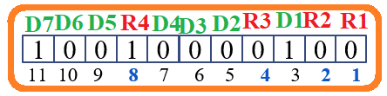
Hamming Code https://www.youtube.com/watch?v=iwj8ZgyzqZk
Consider Example where we send data stream 1000001 [ASCII ‘A’]
Now we will encode the message
Use modulo - 2 to calculate parity bits
2^{r} ≥ m+r+1. (2^4>=7+4+1)=16>=12
R1 = D3, D5, D7, D9, D11 => 1+0+0+0+1 => 0.
R2 = D3, D6, D7, D10, D11 => 1+0+0+0+1 => 0.
R4 = D5, D6, D7 => 0+0+0 => 0.
R8 = D9, D10, D11 => 0+0+1 => 1.
R1 = D3, D5, D7, D9, D11 => (Alternate 1 Bit including r1 itself).
R2 = D3, D6, D7, D10, D11 => (Alternate 2 Bit including r2 itself).
R4 = D5, D6, D7 => (Alternate 4 Bit including r4 itself).
R8 = D9, D10, D11 => (Alternate 8 Bit including r8 itself).
Data stream to be sent on transmission line from sender
1
0
0
1
0
0
0
0
1
0
0
11 10 9 8 7 6 5 4 3 2 1

Slide 36
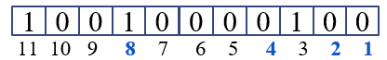
Hamming Code
1000001---data
when this stream is received at receiver same process will be followed for decoding if we are getting same values for parity bits as we got at sender side then we say that transmission was error free
Consider an erroneous stream where 5th bit is flipped.
Data stream to be sent on transmission line from sender
1
0
0
1
0
0
1
0
1
0
0
Data stream received on transmission line from sender
11 10 9 8 7 6 5 4 3 2 1
Now getting corrupted bit position
= (R8, R4, R2, R1)
= (0, 1, 0, 1)₂
= (5)₁₀
R1 = R1, D3, D5, D7, D9, D11 => 0+1+1+0+0+1 => 1.
R2 = R2, D3, D6, D7, D10, D11 => 0+1+0+0+0+1 => 0.
R4 = R4, D5, D6, D7 => 0+1+0+0 => 1.
R8 = R8, D9, D10, D11 => 1+0+0+1 => 0.

Slide 37
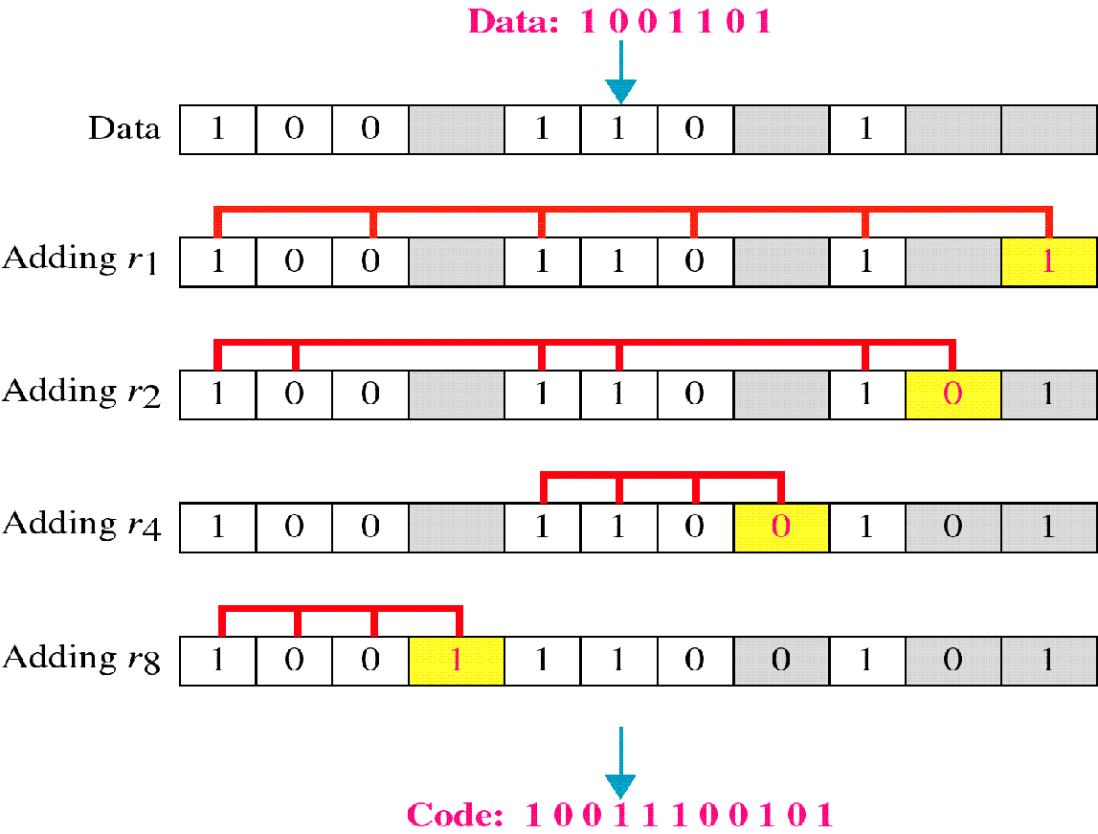
Hamming Code
Use modulo - 2 to calculate parity bits
Consider an Example, Data:1001101
R1 = M3, M5, M7, M9, M11 => 1+0+1+0+1 => 1.
R2 = M3, M6, M7, M10, M11 => 1+1+1+0+1 => 0.
R4 = M5, M6, M7 => 0+1+1 => 0.
R8 = M9, M10, M11 => 0+0+1 => 1.
That is
R1 = M3, M5, M7, M9, M11 => (Alternate 1 Bit including r1 itself).
R2 = M3, M6, M7, M10, M11 => (Alternate 2 Bit including r2 itself).
R4 = M5, M6, M7 => (Alternate 4 Bit including r4 itself).
R8 = M9, M10, M11 => (Alternate 8 Bit including r8 itself).
And so on……..

Slide 38
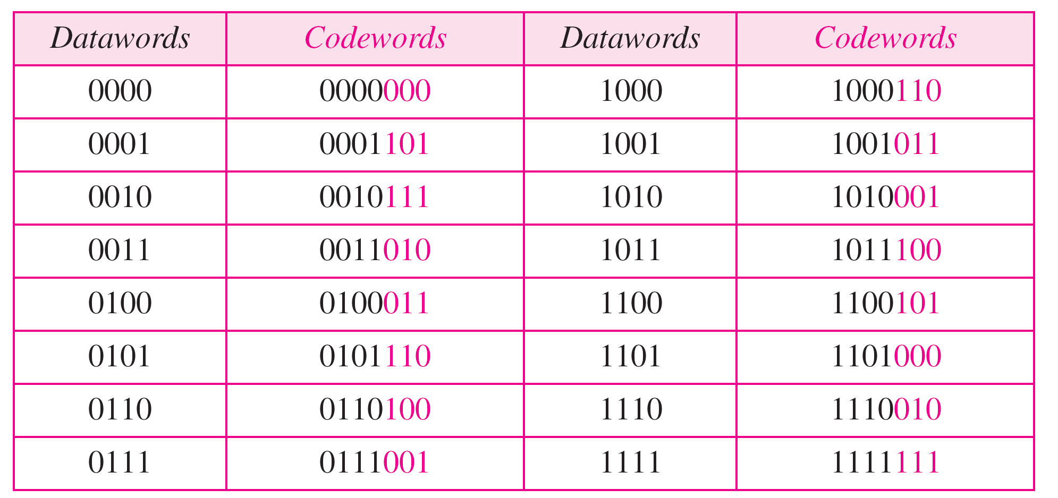
Hamming Code
https://www.youtube.com/watch?v=tcEa2dW3Ajg
Table: Hamming code C(7, 4) - n=7, k = 4

Slide 39
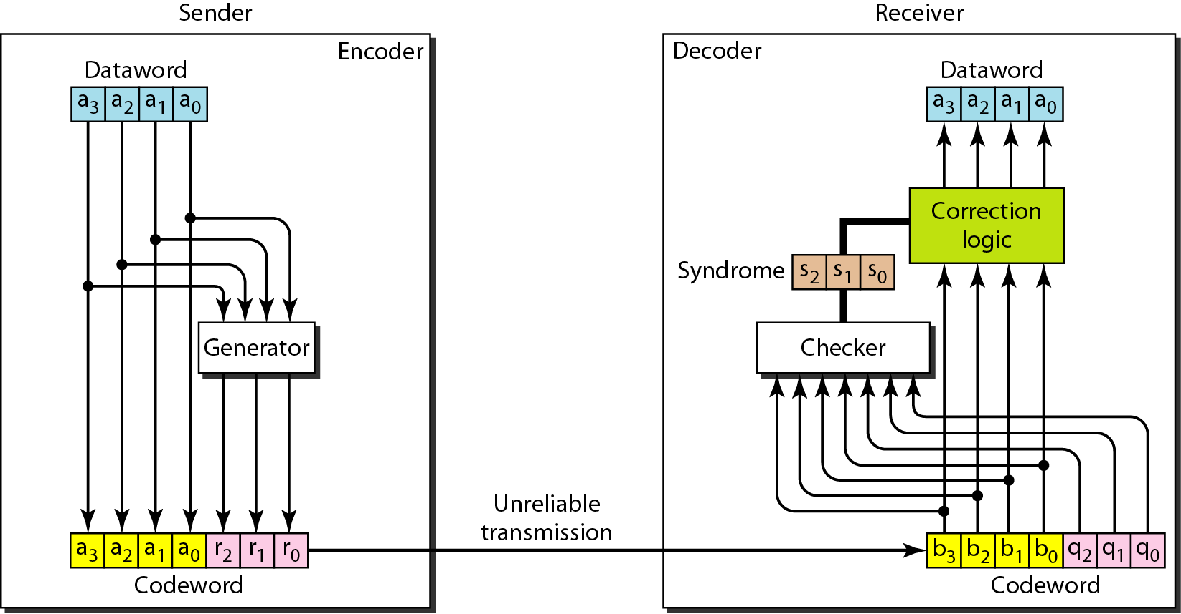
Hamming Code
Encoder and decoder for a Hamming code

Slide 40
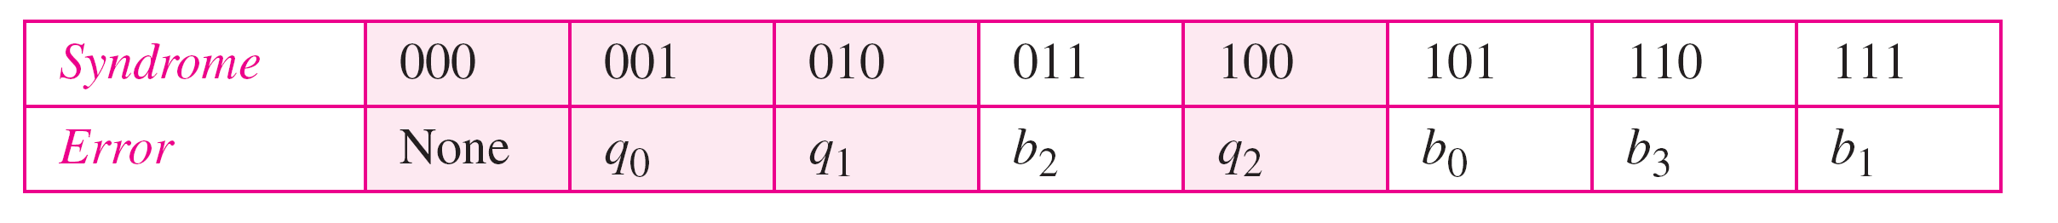
Logical decision made by the correction logic analyzer

Slide 41
Hamming Code
Calculating the parity bits at the transmitter:
Modulo 2 arithmetic:
r₀ = a₂ + a₁ + a₀
r₁ = a₃ + a₂ + a₁
r₂ = a₁ + a₀ + a₃
Calculating the syndrome at the receiver:
s₀ = b₂ + b₁ + b₀
s₁ = b₃ + b₂ + b₁
s₂ = b₁ + b₀ + b₃

Slide 42
Hamming Code for Detecting Burst Errors
Burst errors are very common, in particular in wireless environments where a fade will affect a group of bits in transit. The length of the burst is dependent on the duration of the fade.
One way to counter burst errors, is to break up a transmission into shorter words and create a block (one word per row), then have a parity check per word.
The words are then sent column by column. When a burst error occurs, it will affect 1 bit in several words as the transmission is read back into the block format and each word is checked individually.

Slide 43
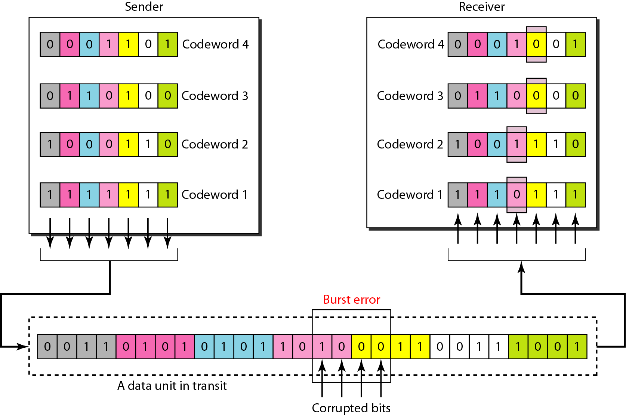
Hamming Code for Burst Errors

Slide 44

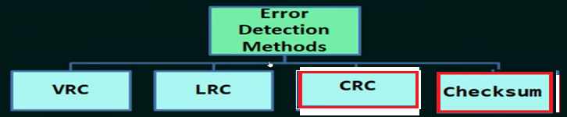
CYCLIC CODES:
Cyclic Redundancy Check (CRC) is an error detection method.
It is based on binary division
Cyclic codes are special linear block codes with one extra property. In a cyclic code, if a codeword is cyclically shifted (rotated), the result is another codeword.

Slide 45
Cyclic Redundancy Check (CRC): Error Detection Technique
Widely used error detection technique is CRC.
CRC codes are also known as polynomial code since it is possible to view the bit string to be sent as a polynomial whose coefficients are the ‘0’ and ‘1’ values in bit stream.
For example 110001 has 6 bits thus represent 6 term polynomial with coefficient 1, 1, 0, 0, 0, and 1 (i.e. 1X5 + 1X4 + 0X3 + 0X2 + 0X1 +1X0).
A ‘k’ – bits frame is regarded as the coefficient list for polynomial with ‘k’ terms ranging from Xk-1 to X0 such polynomial is said to be degree of ‘k-1’.
The high order (left most) bit is the coefficient of Xk-1 the next bit is coefficient of Xk-2 and so on.
Polynomial arithmetic is done in modulo - 2, according to the rules of algebraic field theory.
It does not have carries in addition and borrows in subtraction.
Addition and subtraction both are identical to XOR (⊕).

Slide 46
X5 + X4 +1 is polynomial function means Divisor
For example 110001 has 6 bits thus represent 6 term polynomial with coefficient 1, 1, 0, 0, 0, and 1, What is polynomial function.?
Polynomial=x^3+X^2+1 So what is Divisor value
1101

Slide 47
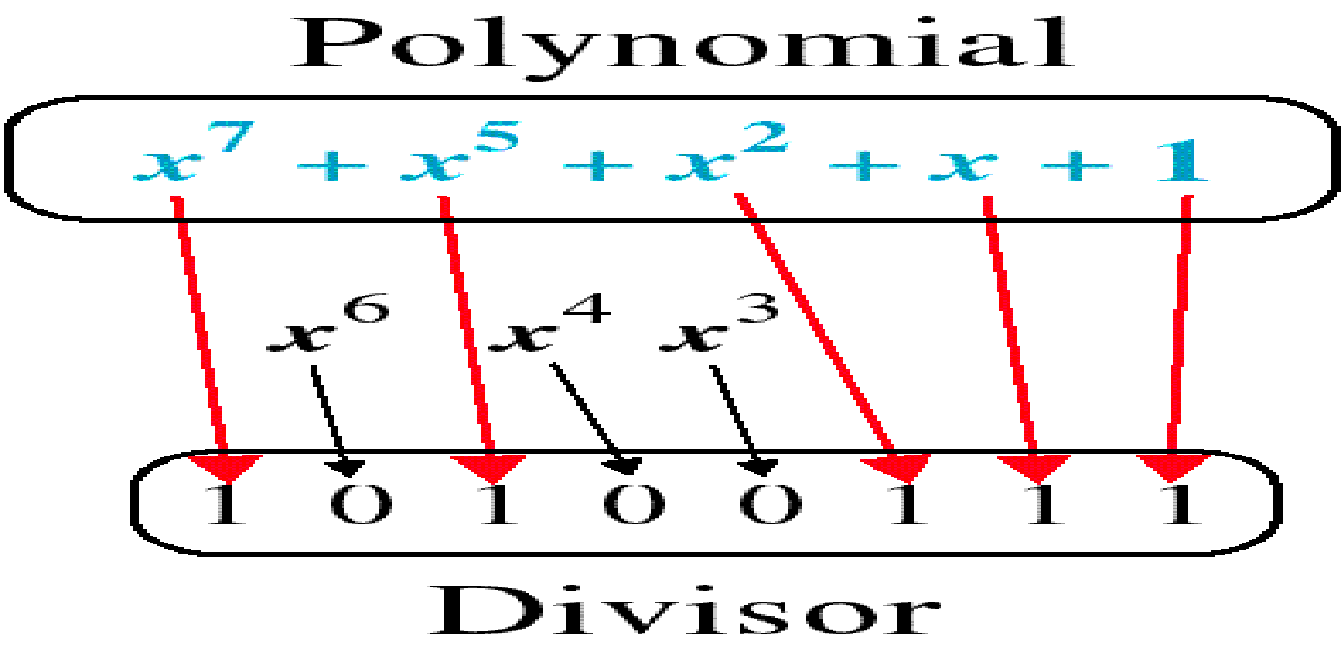
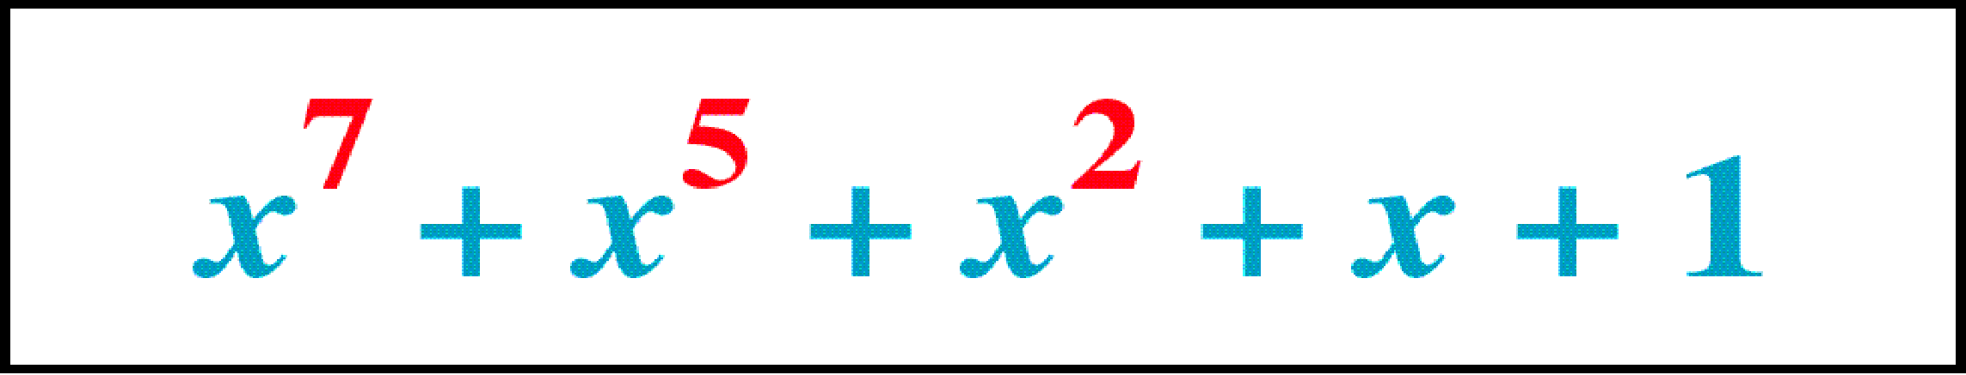
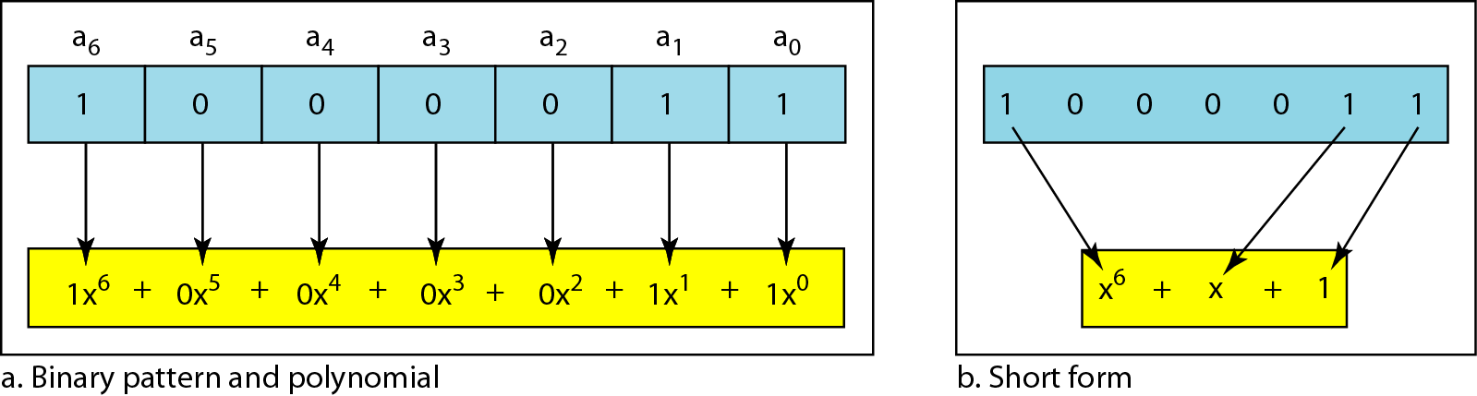
X5 + X4 +1 is Divisor.
For example 110001 has 6 bits thus represent 6 term polynomial with coefficient 1, 1, 0, 0, 0, and 1 (i.e. 1X5 + 1X4 + 0X3 + 0X2 + 0X1 +1X0).
Polynomial

Slide 48
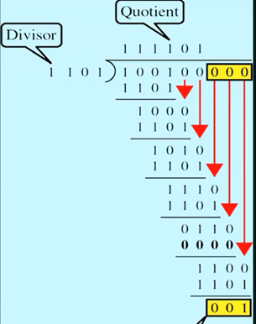
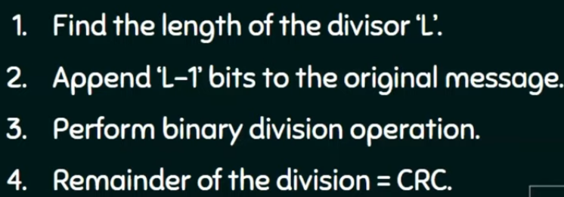
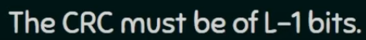
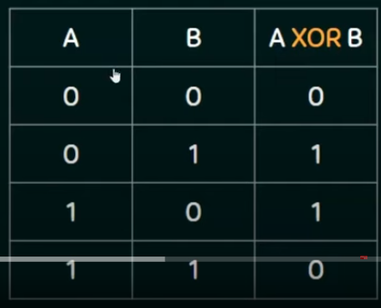
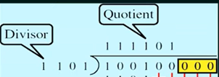
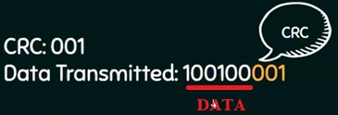
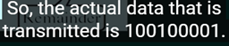
Data-100100 and Divisor=Polynomial=x^3+X^2+1
So Divisor = ?????
So Divisor = 1101

Slide 49
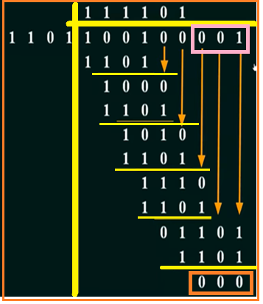
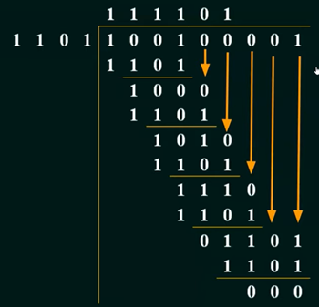
Divisor is same for Transmitter and Receiver.
In given ex. 100100 is data and 001 is CRC
If reminder is zero means no error at receiver
If reminder is zero means no error at receiver

Slide 50
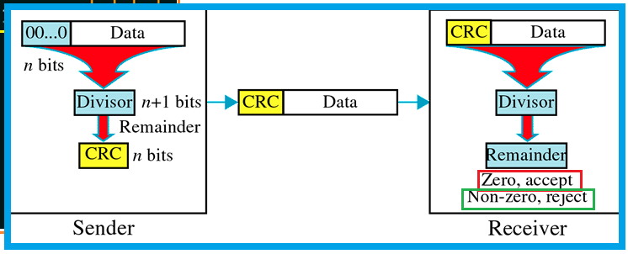
CRC
A cyclic redundancy check (CRC) is an error-detecting code commonly used in digital networks and storage devices to detect accidental changes to raw data

Slide 51
CRC
Given a k-bit frame or message, the transmitter generates an n-bit sequence, known as a frame check sequence (FCS),
The resulting frame, consisting of (k+n) bits, is exactly divisible by some predetermined number.
The receiver then divides the incoming frame by the same number and, if there is no remainder, assumes that there was no error.

Slide 52
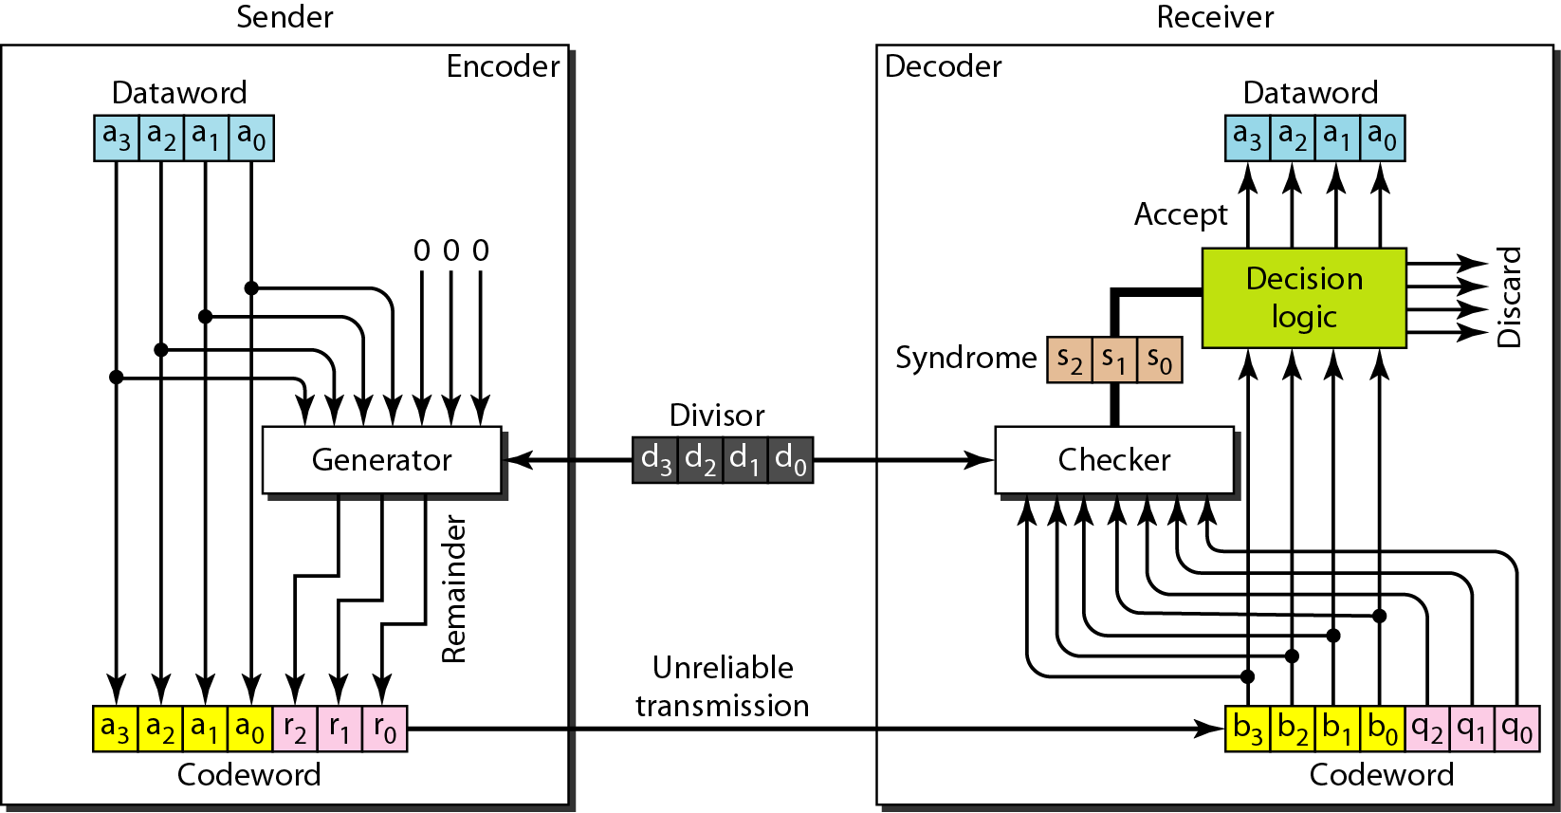
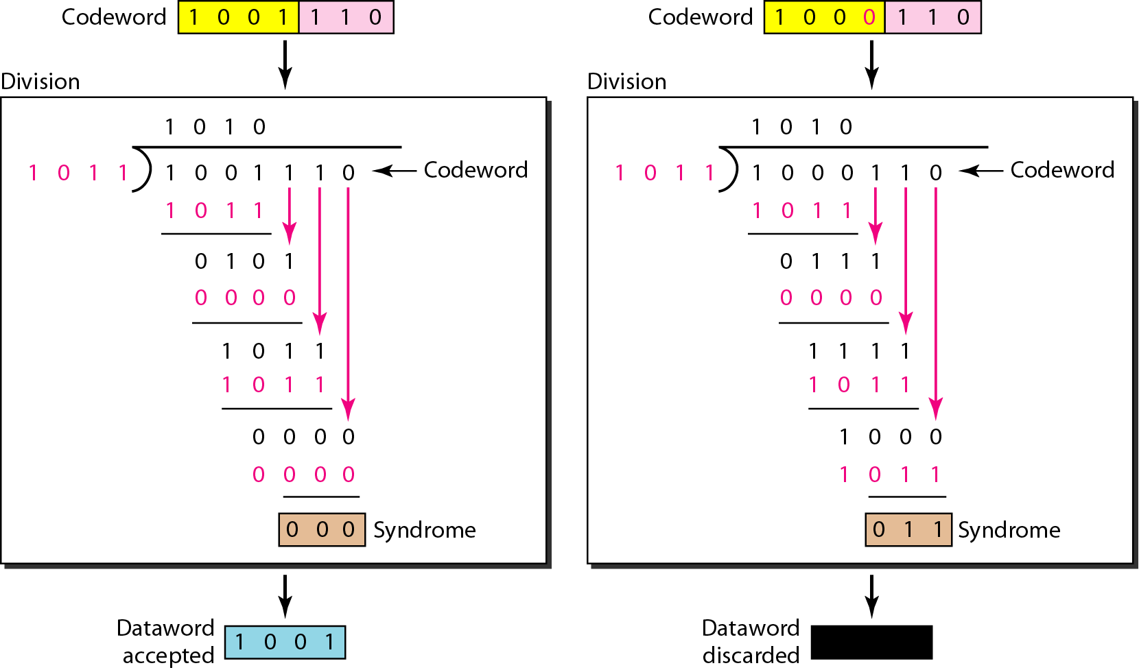
CRC https://www.youtube.com/watch?v=tcEa2dW3Ajg

Slide 53
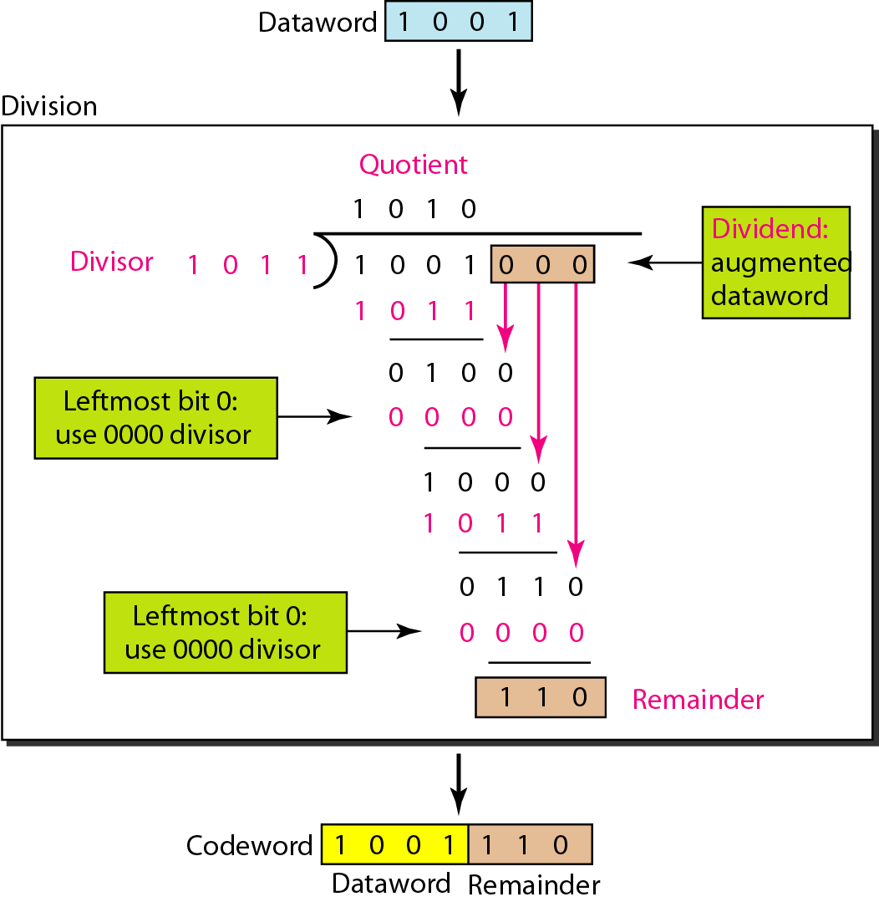

Division in CRC Encoder

Slide 54
Division in CRC Decoder for two cases

Slide 55


CRC Example

Slide 56

CRC
Message = 110101 Polynomial = 101 FIND CRC?

Slide 57


1
2

Slide 58



Slide 59


Standard Polynomials

Slide 60
Checksum (error detection method )
The last error detection method we discuss here is called the checksum.
The checksum is used in the Internet by several protocols although not at the data link layer.
However, we briefly discuss it here to complete our discussion on error checking

Slide 61

Checksum

Slide 62



Checksum

Slide 63




32-bits
ADD all
Carry 1 0
ADD carry if getting
1’s complement means checksum
1 1 0 1 1 0 1 0
Checksum is upended with message

Slide 64




1 1 1 1 1 1 1 1

Slide 65
Steps
On Sender Side
The unit is divided into k sections, each of n bits.
All sections are added together using one’s complement to get the sum.
The sum is complemented and becomes the checksum.
The checksum is sent with the data
On Receiver Side
The unit is divided into k sections, each of n bits.
All sections are added together using one’s complement to get the sum.
The sum is complemented.
If the result is zero, the data are accepted: otherwise, they are rejected.

Slide 66
Performance
The checksum detects all errors involving an odd number of bits.
It detects most errors involving an even number of bits.
If one or more bits of a segment are damaged and the corresponding bit or bits of opposite value in a second segment are also damaged, the sums of those columns will not change and the receiver will not detect a problem.

Slide 67
Checksum Example
How can we represent the number 21 in one’s complement arithmetic using only four bits?
Solution :
The number 21 in binary is 10101 (it needs five bits). We can wrap the leftmost bit and add it to the four rightmost bits. We have (0101 + 1) = 0110 or 6.

Slide 68

Checksum Example
45=101101
1101
+ 10
---------------
1111
Since the value of the checksum is 0, this means that the data is not corrupted. The receiver drops the checksum and keeps the other data items.
If the checksum is not zero, the entire packet is dropped.

Slide 69
Checksum Example
Let us redo Exercise using one’s complement arithmetic.
Figure shows the process at the sender and at the receiver.
The sender initializes the checksum to 0 and adds all data items and the checksum (the checksum is considered as one data item and is shown in color).
The result is 36. However, 36 cannot be expressed in 4 bits. The extra two bits are wrapped and added with the sum to create the wrapped sum value 6.
In the figure, we have shown the details in binary. The sum is then complemented, resulting in the checksum value 9 (15 − 6 = 9). The sender now sends six data items to the receiver including the checksum 9.

Slide 70
Checksum Example
The receiver follows the same procedure as the sender.
It adds all data items (including the checksum); the result is 45. The sum is wrapped and becomes 15.
The wrapped sum is complemented and becomes 0.
Since the value of the checksum is 0, this means that the data is not corrupted. The receiver drops the checksum and keeps the other data items.
If the checksum is not zero, the entire packet is dropped.

Slide 71
Flow Control and Error control
The most important responsibilities of the data link layer are flow control and error control. Collectively, these functions are known as data link control.
Flow control refers to a set of procedures used to restrict the amount of data that the sender can send before waiting for acknowledgment.
Error control in the data link layer is based on automatic repeat request, which is the retransmission of data.

Slide 72
Flow Control
The sending data-link layer at the end of a link is a producer of frames; the receiving data-link layer at the other end of a link is a consumer.
If the rate of produced frames is higher than the rate of consumed frames, frames at the receiving end need to be buffered while waiting to be consumed (processed).
As an unlimited buffer size at the receiving side is not possible, any one of the following steps are followed----
receiving data-link layer drop the frames if its buffer is full.
to let the receiving data-link layer send a feedback to the sending data-link layer to ask it to stop or slow down.
Data-link-layer protocols use different strategies for flow control.

Slide 73

Flow Control
Data-link layer at the sending node tries to push frames toward the data-link layer at the receiving node.
If the receiving node cannot process and deliver the packet to its network at the same rate that the frames arrive, it becomes overwhelmed with frames.
Flow control in this case can be feedback from the receiving node to the sending node to stop or slow down pushing frames.

Slide 74
Flow Control
Flow and error control can be combined.
In a simple situation, the acknowledgment that is sent for flow control can also be used for error control to tell the sender the packet has arrived uncorrupted.
The lack of acknowledgment means that there is a problem in the sent frame.
A frame that carries an acknowledgment is normally called an ACK to distinguish it from the data frame.

Slide 75

Taxonomy of Protocols
Taxonomy : the scientific process of arranging things into groups
Protocol: meaning is that it a set of mutually accepted and implemented rules at both ends of the communications channel for the proper exchange of information.
1
2.
Sliding Window Protocol

Slide 76
Noiseless Channels
Two protocols are used for ideal cases having noiseless channels
1. Simplest Protocol
2. Stop-and-Wait Protocol

Slide 77

Noiseless Channels: 1. Simple Protocol
Let us first assume, we have an ideal channel in which no frames are lost, duplicated, or corrupted. We introduce two protocols for this type of channel.
1. Simplest Protocol
2. Stop-and-Wait Protocol

Slide 78

1. Simple Protocol cont-
The sender sends a sequence of frames without even thinking about the receiver.
To send three frames, three events occur at the sender side and three events at the receiver side.
The data frames are shown by tilted boxes; the height of the box defines the transmission time difference between the first bit and the last bit in the frame.

Slide 79

2. Stop & Wait Protocol
In this protocol, the sender sends one frame at a time and waits for an acknowledgment before sending the next one.

Slide 80

2. Stop & Wait Protocol cont-
The sender sends one frame and waits for feedback from the receiver.
When the ACK arrives, the sender sends the next frame.
Note that sending two frames in the protocol involves the sender in four events and the receiver in two events.

Slide 81
Noisy Channel
Noiseless channels are nonexistent.
For noisy channels, following protocols are used for flow and error control.
Stop-and-Wait Automatic Repeat Request (ARQ)
Go-Back-N Automatic Repeat Request (ARQ)
Selective Repeat Automatic Repeat Request (ARQ)

Slide 82
Stop-and-Wait Automatic Repeat Request (ARQ)
To detect corrupted frames, we need to add a CRC to each data frame. When a frame arrives at the receiver site, it is checked. If its CRC is incorrect, the frame is corrupted and silently discarded.
Every time the sender sends a frame, it starts a timer. If an acknowledgment arrives before the timer expires, the timer is stopped and the sender sends the next frame (if it has one to send).
If the timer expires, the sender resends the previous frame, assuming that the frame was either lost or corrupted.
Sender needs to keep a copy of the frame until its acknowledgment arrives. When the corresponding acknowledgment arrives, the sender discards the copy and sends the next frame if it is ready.
Note that only one frame and one acknowledgment can be in the channels at any time.

Slide 83

1. Stop-and-Wait Automatic Repeat Request (ARQ)

Slide 84

Stop-and-Wait [without sequence number]

Slide 85
Stop-and-Wait [without sequence number]
Duplicate packets, as much as corrupted packets, need to be avoided.
To correct the problem, we need to add sequence numbers to the data frames and acknowledgment numbers to the ACK frames.
A 1-bit sequence number/acknowledgement number (0 or 1) is therefore sufficient.

Slide 86

Stop-and-Wait [with sequence number]

Slide 87
Stop-and-Wait Automatic Repeat Request (ARQ)
Error correction in Stop-and-Wait ARQ is done by keeping a copy of the sent frame and retransmitting of the frame when the timer expires.
In Stop-and-Wait ARQ, we use sequence numbers to number the frames. The sequence numbers are based on modulo-2 arithmetic.
In Stop-and-Wait ARQ, the acknowledgment number always announces in modulo-2 arithmetic the sequence number of the next frame expected.
Aim of stop & wait protocol is to turn unreliable data link into reliable one.
Therefore Stop & Wait protocol is suitable for large sizes of packets.
Similarly Stop & Wait protocol is suitable for small size networks (i.e. LAN)

Slide 88

Stop-and-Wait Automatic Repeat Request (ARQ) : Example
Frame 0 is sent and acknowledged.
Frame 1 is lost and resent after the time-out.
The resent frame 1 is acknowledged and the timer stops.
Frame 0 is sent and acknowledged, but the acknowledgment is lost.
The sender has no idea if the frame or the acknowledgment is lost, so after the time-out, it resends frame 0, which is acknowledged.

Slide 89

Sliding Window Protocol
Suppose that we have sender window and receiver window each of size 4.
So the sequence numbering of both the windows will be 0,1,2,3,0,1,2 and so on.
The diagram shows the positions of the windows after sending the frames and receiving acknowledgments.
sequence numbering
The sliding window is a technique for sending multiple frames at a time.

Slide 90
Sliding Window Protocol cont-
The sliding window is a technique for sending multiple frames at a time.
It controls the data packets between the two devices where reliable and gradual delivery of data frames is needed
In this technique, each frame has sent from the sequence number.
The sequence numbers are used to find the missing data in the receiver end.
The purpose of the sliding window technique is to avoid duplicate data, so it uses the sequence number.

Slide 91

Types of Sliding Window Protocol

Slide 92


Go-Back-N ARQ
Selective Repeat ARQ

Slide 93
Go-Back-N ARQ
Go-Back-N ARQ protocol is also known as Go-Back-N Automatic Repeat Request.
It is a data link layer protocol that uses a sliding window method.
In this, if any frame is corrupted or lost, all subsequent frames have to be sent again.
The frames are sequentially numbered and a finite number of frames are sent.
If the acknowledgment of a frame is not received within the time period, all frames starting from that frame are retransmitted.

Slide 94
Go-Back-N ARQ

Slide 95
Go-Back-N ARQ
In these protocols, the sender has a buffer called the sending window and the receiver has buffer called the receiving window.
The size of the sending window determines the sequence number of the outbound frames.
If the sequence number of the frames is an n-bit field, then the range of sequence numbers that can be assigned is 0 to 2^{𝑛}−1.
Consequently, the size of the sending window is 2^{𝑛}−1. Thus in order to accommodate a sending window size of 2^{𝑛}−1, a n-bit sequence number is chosen.
The sequence numbers are numbered as modulo-n.
For example, if the sending window size is 4, then the sequence numbers will be 0, 1, 2, 3, 0, 1, 2, 3, 0, 1, and so on. The number of bits in the sequence number is 2 to generate the binary sequence 00, 01, 10, 11.
The size of the receiving window is the maximum number of frames that the receiver can accept at a time.
It determines the maximum number of frames that the sender can send before receiving acknowledgment.

Slide 96
Selective Repeat ARQ
The Go-back-N ARQ protocol works well if it has fewer errors.
But if there is a lot of error in the frame, lots of bandwidth loss in sending the frames again.
In the Selective Repeat ARQ protocol, the size of the sender window is always equal to the size of the receiver window. The size of the sliding window is always greater than 1.
If the receiver receives a corrupt frame, it does not directly discard it.
It sends a negative acknowledgment to the sender.
The sender sends that frame again as soon as on the receiving negative acknowledgment.
There is no waiting for any time-out to send that frame.

Slide 97
Selective Repeat ARQ

Slide 98


Slide 99

Channel Allocation
Channel allocation is a process in which a single channel is divided and allotted to multiple users in order to carry user specific tasks.

Slide 100
Static Channel Allocation
In static channel allocation scheme, a fixed portion of the frequency channel is allotted to each user.
For N competing users, the bandwidth is divided into N channels using Frequency Division Multiplexing (FDM), and each portion is assigned to one user.
This scheme is also called as fixed channel allocation or fixed channel assignment.
There is no interference between the users since each user is assigned a single channel.
It is not suitable in case of a large number of users with variable bandwidth requirements

Slide 101
Dynamic Channel Allocation
In dynamic channel allocation scheme, frequency bands are not permanently assigned to the users.
Instead, channels are allotted to users dynamically as needed, from a central pool.
The allocation is done considering a number of parameters so that transmission interference is minimized.
This allocation scheme optimizes bandwidth usage and results is faster transmissions.
Dynamic channel allocation is further divided into Centralized and Distributed allocation.

Slide 102
Dynamic Channel Allocation Assumptions
Station Model: Assumes that each of N stations independently produce frames. The probability of producing a packet in the interval IDt where I is the constant arrival rate of new frames.
Single Channel Assumption: In this allocation all stations are equivalent and can send and receive on that channel.
Collision Assumption: If two frames overlap in time-wise, then that’s collision. Any collision is an error, and both frames must re transmitted. Collisions are only possible error.
Time: can be divided into Slotted or Continuous.
Stations: can sense a channel is busy before they try it.

Slide 103


Multiple Access Protocols

Slide 104


Multiple Access Protocols
Multiple Access Protocol is required to reduce the collision and avoid crosstalk between the channels.

Slide 105

Multiple Access Protocols
Additive Links On-line Hawaii Area. (system developed at the University of Hawaii.)
Frequency-
Division Multiple Access
Carrier Sense Multiple Access
Time
Division Multiple Access
Collision Detection
Code-
Division Multiple Access
Collision Avoidance

Slide 106
Why Multiple Access Protocol is required?
A data link control is a reliable channel for transmitting data over a dedicated link using various techniques such as framing, error control and flow control of data packets in the computer network.
When a sender and receiver have a dedicated link to transmit data packets, the data link control is enough to handle the channel.
Suppose there is no dedicated path to communicate or transfer the data between two devices, then multiple stations access the channel and simultaneously transmit the data over the channel.
It may create collision and cross talk.
Hence, the multiple access protocol is required to reduce the collision and avoid crosstalk between the channels.

Slide 107


Multiple Access Protocol: Random Access Protocol

Slide 108

Multiple Access Protocols: Random Access Protocol
No station is superior to another station and none is assigned the control over another.
No station permits, or does not permit, another station to send.
At each instance, a station that has data to send uses a procedure defined by the protocol to make a decision on whether or not to send.
Multiple Access Protocols:
ALOHA (Pure and Slotted ALOHA)---Additive Links On-line Hawaii Area. (system developed at the University of Hawaii.)
CSMA
CSMA/CD
CSMA/CA

Slide 109
ALOHA
It is designed for Wireless LAN (Local Area Network) but can also be used in a shared medium to transmit data.
Using this method, any station can transmit data across a network simultaneously when a data frameset is available for transmission.
Aloha Rules:
Any station can transmit data to a channel at any time.
It does not require any carrier sensing.
Collision and data frames may be lost during the transmission of data through multiple stations.
Acknowledgment of the frames exists in Aloha. Hence, there is no collision detection.
It requires retransmission of data after some random amount of time.

Slide 110




ALOHA

Slide 111


Pure ALOHA
Slotted ALOHA

Slide 112

Pure ALOHA

Slide 113



Slide 114
There are four stations for accessing a shared channel and transmitting data frames.
Some frames collide because most stations send their frames at the same time.
Only two frames, frame 1.1 and frame 2.2 is successfully transmitted to the receiver end.
At the same time, other frames are lost or destroyed.
Whenever two frames fall on a shared channel simultaneously, collisions can occur, and both will suffer damage.
If the new frame's first bit enters the channel before finishing the last bit of the second frame.
Pure ALOHA

Slide 115
Pure ALOHA
Whenever data is available for sending over a channel at stations, we use Pure Aloha.
In pure Aloha each station transmits data to a channel without checking whether the channel is idle or not
the chances of collision may occur, and the data frame can be lost.
When any station transmits the data frame to a channel, the pure Aloha waits for the receiver's acknowledgment.
If it does not acknowledge the receiver end within the specified time, the station waits for a random amount of time, called the backoff time (Tb).
And the station may assume the frame has been lost or destroyed.
Therefore, it retransmits the frame until all the data are successfully transmitted to the receiver.

Slide 116

Pure ALOHA

Slide 117
Pure ALOHA
Efficiency-
Efficiency of Pure Aloha (η) = G x e^{-2G}
where G = Number of stations willing to transmit data
Maximum Efficiency-
For maximum efficiency,
We put dη / dG = 0
Maximum value of η occurs at G = 1/2
Substituting G = 1/2 in the above expression, we get-
Maximum efficiency of Pure Aloha
= 1/2 x e^{-2 x 1/2}
= 1 / 2e
= 0.184
= 18.4%
The total vulnerable time of pure Aloha is 2 * Tfr.
Maximum throughput occurs when G = 1/ 2 that is 18.4%.
Successful transmission of data frame is S = G * e ^ - 2 G.

Slide 118



Slotted ALOHA

Slide 119
Slotted ALOHA
The slotted Aloha is designed to overcome the pure Aloha's efficiency because pure Aloha has a very high possibility of frame hitting.
In slotted Aloha, the shared channel is divided into a fixed time interval called slots.
if a station wants to send a frame to a shared channel, the frame can only be sent at the beginning of the slot, and only one frame is allowed to be sent to each slot.
if the stations are unable to send data to the beginning of the slot, the station will have to wait until the beginning of the slot for the next time.
However, the possibility of a collision remains when trying to send a frame at the beginning of two or more station time slot.

Slide 120
Slotted ALOHA
Maximum throughput occurs in the slotted Aloha when G = 1 that is 37%.
The probability of successfully transmitting the data frame in the slotted Aloha is S = G * e ^ - 2 G.
The total vulnerable time required in slotted Aloha is Tfr.

Slide 121
Slotted ALOHA
Efficiency-
Efficiency of Slotted Aloha (η) = G x e^{-G}
where G = Number of stations willing to transmit data at the beginning of the same time slot
Maximum Efficiency-
For maximum efficiency,
We put dη / dG = 0
Maximum value of η occurs at G = 1
Substituting G = 1 in the above expression, we get-
Maximum efficiency of Slotted Aloha
= 1 x e⁻¹
= 1 / e
= 0.368
= 36.8%
Maximum throughput occurs in the slotted Aloha when G = 1 that is 37%.
The probability of successfully transmitting the data frame in the slotted Aloha is S = G * e ^ - 2 G.
The total vulnerable time required in slotted Aloha is Tfr.

Slide 122

Vulnerable period for Pure ALOHA
Vulnerable Time: The propagation time is referred to as vulnerable time in the CSMA and it is denoted as Tp.
This is basically the time a signal needed by a signal in order to propagate from one end of the medium to another end.

Slide 123





Vulnerable period for Slotted ALOHA

Slide 124

G = Number of stations willing to transmit data

Slide 125
Answer the following question
A group of N stations share 100 Kbps slotted ALOHA channel. Each station output a 500 bits frame on an average of 5000 ms even if previous one has not been sent. What is the required value of N?

Slide 126
Answer
Throughput Of One Station-
Throughput of each station
= Number of bits sent per second
= 500 bits / 5000 ms
= 500 bits / (5000 x 10⁻³ sec)
= 100 bits/sec
Total Number Of Stations-
Throughput of slotted aloha = Total number of stations x Throughput of each station
Substituting the values, we get-
36.8 Kbps = N x 100 bits/sec
∴ N = 368
Thus, required value of N = 368.
Throughput Of Slotted Aloha-
Throughput of slotted aloha
= Efficiency x Bandwidth
= 0.368 x 100 Kbps
= 36.8 Kbps

Slide 127


2. Carrier Sense Multiple Access (CSMA)

Slide 128
Carrier Sense Multiple Access protocols cont-
It is a Carrier Sense Multiple Access based on media access protocol to sense the traffic on a channel (idle or busy) before transmitting the data.
It means that if the channel is idle, the station can send data to the channel. Otherwise, it must wait until the channel becomes idle.
Hence, it reduces the chances of a collision on a transmission medium.
CSMA method was developed to decrease the chances of collisions when two or more stations start sending their signals over the data link layer.

Slide 129

Carrier Sense Multiple Access Protocols cont-

Slide 130

Carrier Sense MA Protocols
But, what to do if the channels are busy? Now, here the persistence methods can be applied to help the station act when the channel is busy or idle.

Slide 131



Access Modes in CSMA
P----Probability

Slide 132
Difference between 1-persistent, p-persistent and Non-persistent CSMA
Parameter | 1-persistent CSMA | p-persistent CSMA | Non-persistent CSMA (Zero-0)
Carrier Sense | It sends with the probability of 1 when channel is idle. | It sends with the probability of p when channel is idle. | It send when channel is idle.
Waiting | It continuously senses the channel or carrier. | It waits for the next time slot. | It will wait for the random amount of time to check the carrier.
Chances of Collision | There is highest chances of collision in this. | Less chances as compared to 1-persistence and non-persistence. | Less chances as compared to 1-persistence but more than the p-persistence.
Utilization | It’s utilization is above ALOHA as frames are only sent when the channel is idle. | It’s utilization is depend upon the probability p. | It’s utilization is above 1-persistent as not all the stations constantly check the channel at the same time.
Delay Low Load | It is low as frames are sent when the channel become idle. | It is large when p is small as station will not always send when channel is idle. | It is small as station will send whenever channel is found idle but longer than 1-persistent since it checks for the random time when busy.
Delay High Load | It is high due to collision. | It is large when the probability p of sending is small when channel is idle and channel is rarely idle. | It is longer than 1-persistent as channel is checked randomly when busy.

Slide 133


Slide 134



Slide 135
Carrier Sense Multiple Access (CSMA)
1-persistent mode

Slide 136
CSMA-Carrier Sense MA protocols
Protocols in which stations listen for a carrier (i.e. a transmission medium) and act accordingly, e.g. MA protocols used by LANs.
1-Persistent CSMA
When a station has data to send, it listens to the channel.
If the channel is busy, it waits until channel idle.
When the channel is idle, it transmits a frame (with probability = 1).
Propagation delay effect:
At t0, station 1 detects idle and sends a frame.
At t0+τ−ε, station 2 detects idle and sends a frame.2
At t0+τ, station 2 detects collision.

Slide 137

Carrier Sense Multiple Access (CSMA)
Non-persistent mode

Slide 138

https://www.youtube.com/watch?v=MAZi6VoekYw&list=PLBlnK6fEyqRgMCUAG0XRw78UA8qnv6jEx&index=72

Slide 139

probability

Slide 140

Carrier Sense Multiple Access (CSMA)
P-persistent mode

Slide 142
Carrier Sense Multiple Access (CSMA)
At t0+τ−ε+τ, station 1 detects collision.
In worst case, only about 2τ time later can station 1 detect the collision.
The longer the cable, the longer stations have to wait to be sure that there is
no collision.
Non-persistent CSMA
If the channel is busy, it waits for random period then sense the channel again.
Better channel utilization but longer delays than 1-persistent CSMA.
p-persistent CSMA (applies to slotted channel)
If the channel is idle, it transmits with prob = p (with 1-p, it defers until next slot).
If the next slot is idle again, do the same thing.

Slide 143



Slide 144
Difference between CSMA CA and CSMA CD
S. No | CSMA CD | CSMA CA
1. | It is the type of CSMA to detect the collision on a shared channel. | It is the type of CSMA to avoid collision on a shared channel.
2. | It is the collision detection protocol. | It is the collision avoidance protocol.
3. | It is used in 802.3 Ethernet network cable. | It is used in the 802.11 Ethernet network.
4. | It works in wired networks. | It works in wireless networks.
5. | It is effective after collision detection on a network. | It is effective before collision detection on a network.
6. | Whenever a data packet conflicts in a shared channel, it resends the data frame. | Whereas the CSMA CA waits until the channel is busy and does not recover after a collision.
7. | It minimizes the recovery time. | It minimizes the risk of collision.
8. | The efficiency of CSMA CD is high as compared to CSMA. | The efficiency of CSMA CA is similar to CSMA.
9. | It is more popular than the CSMA CA protocol. | It is less popular than CSMA CD.

Slide 145

CSMA with Collision Detection- CSMA/CD
States of CSMA/CD: contention, transmission or idle
The Carrier Sense Multiple Access/ Collision Detection protocol is used to detect a collision in the media access control (MAC) layer. Once the collision was detected, the CSMA CD immediately stopped the transmission by sending the signal so that the sender does not waste all the time to send the data packet.

Slide 146


Slide 147



Slide 148





Slide 149

Persistent and Non persistent CSMA
Comparison of the channel utilization versus load for various random access protocols.

Slide 150

CSMA/CA (MACA) (Multiple Access with Collision Avoidance)

Slide 151
What is Ethernet?
Ethernet is data link Protocol
In Standard Ethernet, the MAC sublayer governs the operation of the access method.
It also frames data received from the upper layer and passes them to the physical layer.

Slide 152


Slide 153



Slide 154
Ethernet Frame format
IEEE Standards
Ethernet: It is a LAN protocol that is used in Bus and Star topologies and implements CSMA/CD technology as the medium access method
DIX: Original (traditional) Ethernet developed in 1980 by three companies: Digital, Intel, Xerox (DIX).
Project 802: In 1985, the Computer Society of the IEEE started a project, called Project 802, to set standards to enable intercommunication among equipment from a variety of manufacturers.
Current version is called IEEE Ethernet.

Slide 155


Ethernet Frame format
FCS
FCS
Frame formats. (a) DIX (Digital, Intel, Xerox) Ethernet , (b) IEEE 802.3.

Slide 156

IEEE 802.3 MAC frame
(101010………….10)
46 Bytes to
1500 Bytes
MAC
MAC
Preamble Field: Is that alerts the receiving system to the coming frame and enables it to synchronize its input timing. The pattern provides only an alert and a timing pulse. The 56-bit pattern allows the stations to miss some bits at the beginning of the frame.
The preamble is actually added at the physical layer and is not (formally) part of the frame.
Length/Type: Frame length is 16 bits=2^16=0 t0 65536 bits

Slide 157
Content
In IEEE 802.3 Ethernet Data link layer is split into two sublayers:
Bottom part: MAC
The frame is called IEEE 802.3
Handles framing, MAC addressing, Medium Access control
Specific implementation for each LAN protocol
Defines CSMA/CD as the access method for Ethernet LANs and Token passing method for Token Ring.
Implemented in hardware
Top part: LLC (Logical Link Control)
The subframe is called IEEE 802.2
Provides Error and Flow control if needed
It makes the MAC sublayer transparent
Allows interconnectivity between different LANs data link layers
Used to multiplex multiple network layer protocols in the data link layer frame
Implemented in software

Slide 158
Types of IEEE Cable: Ethernet 802.3
Name / Topology | Cable Max. | Max Cable Segment Length | Nodes / Segment
10Base5 / Bus | Thick coax | 500 meters | 100
10Base2 / Bus | Thin coax | 200 meters | 30
10BaseT / Star | Twisted pair | 100 meters | 1
10BaseF / Star | Fiber Optic | 2K meters | 1

Slide 159
Frequently Asked Questions
Explain what might happen if two stations are accidentally assigned the same hardware address?
Why wireless LAN can not use the same CSMA/CD mechanism that Ethernet uses?
Complete given table and answer yes or no-
Characteristic | CSMA/CD | CSMA/CA | Token Ring
Multiple access
Carrier Sense
Collision checking
Acknowledgement

Slide 160
References
Text Books:
Behrouz A. Forouzan, ‘Data Communications and Networking’, 5th Edition, McGraw-Hill Publishing Company, ISBN 978-0-07-337622-6
Tanenbaum A. S., ‘Computer Networks’, Pearson Education , 5th Edition, ISBN-978-0-13-212695-3
Reference Books:
James F. Kurose and Keith W Ross ‘Computer Networking, A Top-Down Approach’, 5th Edition, Pearson Education, ISBN- 978-81-317-9054-0
W. Richard Stevens, Unix Network Programming, The Sockets Networking API, Vol 1, 3rd Edition, PHI Learning Pvt. Ltd.
Supplementary Reading:
William Stallings, ‘Data and Computer Communications’, 6th Edition, Prentice Hall of India Pvt.
Web Resources:
https://nptel.ac.in/courses/106/105/106105080/
https://nptel.ac.in/courses/106/106/106106091/
Web links:
https://nptel.ac.in/courses/106/105/106105081/
https://nptel.ac.in/courses/106/105/106105183/
https://ocw.mit.edu/courses/electrical-engineering-and-computer-science/6-829-computer-networks-fall-2002/index.htm
MOOCs:
https://www.coursera.org/learn/computer-networking
https://www.edx.org/course/introduction-to-networking?index=product&queryID=0befdc538866babf2facfdc2dce06204&position=1

Slide 161
Thank You
Any Questions

Slide 162
MAC Address is also called as Ethernet Address

Slide 163
Network Layer
The network layer works for the transmission of data from one host to the other located in different networks.
It also takes care of packet routing i.e. selection of the shortest path to transmit the packet, from the number of routes available.
The sender & receiver’s IP addresses are placed in the header by the network layer.

Slide 164
Functions of Network Layer
Routing:
The network layer protocols determine which route is suitable from source to destination. This function of the network layer is known as routing.
Logical Addressing:
In order to identify each device on internetwork uniquely, the network layer defines an addressing scheme.
The sender & receiver’s IP addresses are placed in the header by the network layer. Such an address distinguishes each device uniquely and universally.
Segment in Network layer is referred to as Packet. Network layer is implemented by networking devices such as routers.

Slide 165
Transport Layer
The transport layer provides services to the application layer and takes services from the network layer.
The data in the transport layer is referred to as Segments.
It is responsible for the End to End Delivery of the complete message.
The transport layer also provides the acknowledgement of the successful data transmission and re-transmits the data if an error is found.

Slide 166
Transport Layer
At sender’s side: Transport layer receives the formatted data from the upper layers, performs Segmentation, and also implements Flow & Error control to ensure proper data transmission.
It also adds Source and Destination port numbers in its header and forwards the segmented data to the Network Layer.
Note: The sender needs to know the port number associated with the receiver’s application. Generally, this destination port number is configured, either by default or manually. For example, when a web application makes a request to a web server, it typically uses port number 80, because this is the default port assigned to web applications. Many applications have default ports assigned.

Slide 167
Transport Layer
Receiver side: Transport Layer reads the port number from its header and forwards the Data which it has received to the respective application.
It also performs sequencing and reassembling of the segmented data.

Slide 168
Functions of Transport Layer
Segmentation and Reassembly:
This layer accepts the message from the (session) layer, breaks the message into smaller units. Each of the segments produced has a header associated with it. The transport layer at the destination station reassembles the message.
Service Point Addressing:
In order to deliver the message to the correct process, the transport layer header includes a type of address called service point address or port address. Thus by specifying this address, the transport layer makes sure that the message is delivered to the correct process.

Slide 169
Services provided by Transport Layer
Connection-Oriented Service: It is a three-phase process that includes – Connection Establishment – Data Transfer – Termination / disconnection In this type of transmission, the receiving device sends an acknowledgement, back to the source after a packet or group of packets is received. This type of transmission is reliable and secure.
Connectionless service: It is a one-phase process and includes Data Transfer. In this type of transmission, the receiver does not acknowledge receipt of a packet. This approach allows for much faster communication between devices..

Slide 170
Services provided by Transport Layer
Data in the Transport Layer is called as Segments.
Transport layer is operated by the Operating System. It is a part of the OS and communicates with the Application Layer by making system calls.
Transport Layer is called as Heart of OSI model.

Slide 171
Session Layer
This layer is responsible for -
Establishment of connection,
Maintenance of sessions,
Authentication, and
Ensures security.

Slide 172
Functions of Session Layer
Session establishment, maintenance, and termination: The layer allows the two processes to establish, use and terminate a connection.
Synchronization: This layer allows a process to add checkpoints which are considered synchronization points into the data. These synchronization points help to identify the error so that the data is re-synchronized properly, and ends of the messages are not cut prematurely and data loss is avoided.
Dialog Controller: The session layer allows two systems to start communication with each other in half-duplex or full-duplex.

Slide 173

Functions of Session Layer
SCENARIO: Let’s consider a scenario where a user wants to send a message through some Messenger application running in his browser. The “Messenger” here acts as the application layer which provides the user with an interface to create the data. This message or so-called Data is compressed, encrypted (if any secure data), and converted into bits (0’s and 1’s) so that it can be transmitted.

Slide 174
Presentation Layer
The presentation layer is also called the Translation layer.
The data from the application layer is extracted here and manipulated as per the required format to transmit over the network.

Slide 175
Functions of Presentation Layer
Translation: For example, ASCII to EBCDIC.
Encryption/ Decryption: Data encryption translates the data into another form or code. The encrypted data is known as the ciphertext and the decrypted data is known as plain text. A key value is used for encrypting as well as decrypting data.
Compression: Reduces the number of bits that need to be transmitted on the network.

Slide 176
Application Layer
At the very top of the OSI Reference Model stack of layers, we find the Application layer which is implemented by the network applications.
These applications produce the data, which has to be transferred over the network.
This layer also serves as a window for the application services to access the network and for displaying the received information to the user.
Ex: Application – Browsers, Skype Messenger, etc. **Application Layer is also called Desktop Layer.

Slide 177
Functions of Application Layer
Network Virtual Terminal
FTAM-File transfer access and management
Mail Services
Directory Services

